Slide 1
CompTIA A+ Certification 801 Support Skills
Unit 1.5 Peripherals and
Expansion Slots

Slide 2
Describe the functions and capabilities of input devices (Keyboard, Mouse, KVM, Game pad, Biometric devices, and touch screens)
Install and configure peripheral devices
Identify expansion bus slots and cards and describe the features of different bus standards
Install expansion cards
Unit 1.5 Peripherals and Expansion Slots
Slide <number>

Slide 3
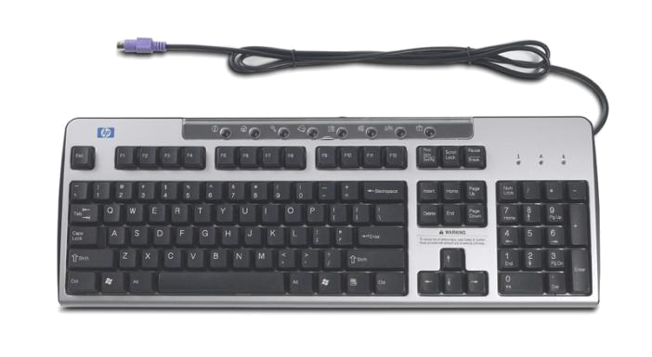
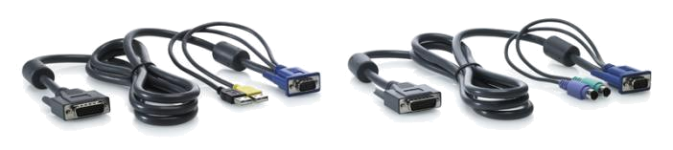
Input Devices
Keyboard
  PC keys
  Numeric keypad
Mouse
  Mechanical
  Laser / optical
KVM
Game pad
Biometric
Unit 1.5 Peripherals and Expansion Slots
Slide <number>

Slide 4
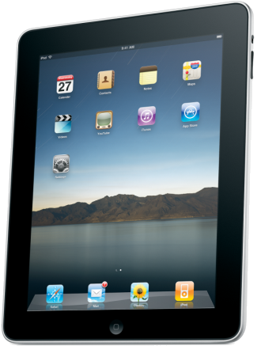
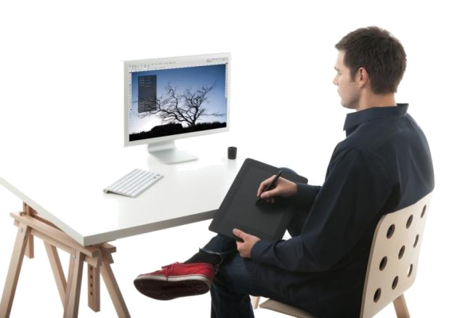
Touch Screens and Digitizers
Touch screens
  Capacitive
  High clarity
  Multi-touch
  Usually used with finger
Digitizer
  Graphics tablets
  Usually used with stylus
Unit 1.5 Peripherals and Expansion Slots
Slide <number>

Slide 5
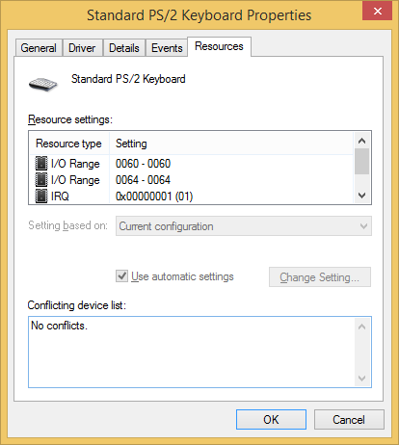
Installing and Configuring Peripherals
Plug-and-Play
  OS detects device automatically
  Locates and installs driver (or prompts if driver cannot be found)
  Assigns system resources
System resources
  Memory address
  I/O port
  Interrupt (IRQ)
Hot-swappable / hot-pluggable
Unit 1.5 Peripherals and Expansion Slots
Slide <number>

Slide 6
Installing a Device
Always read the manufacturer's instructions and check that the device is compatible with the PC and operating system
Hold the connector not the cable when removing a lead
Inspect the connector and port for damage (notably broken or bent pins) before attaching a lead
Take care to align the connector carefully and do not use excessive force, to avoid damaging the pins (PS/2 connectors are particularly fragile)
Check whether the device requires an external power source
If you plug a USB 2.0 device into a USB 1.1 port, a notification message will be displayed, helpfully telling you that the device could perform faster if plugged into a High Speed port
Unit 1.5 Peripherals and Expansion Slots
Slide <number>

Slide 7
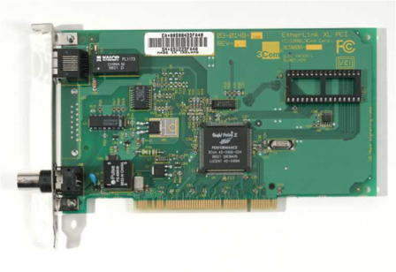
Expansion Bus
Adapter cards add functionality
Plug into specific slot on motherboard
Motherboards provide a number of slots, usually of different types
Legacy
  ISA / EISA (Extended Industry Standard Architecture)
  MCA (Micro Channel Architecture)
  VESA (Video Electronics Standards Association)
Unit 1.5 Peripherals and Expansion Slots
Slide <number>

Slide 8
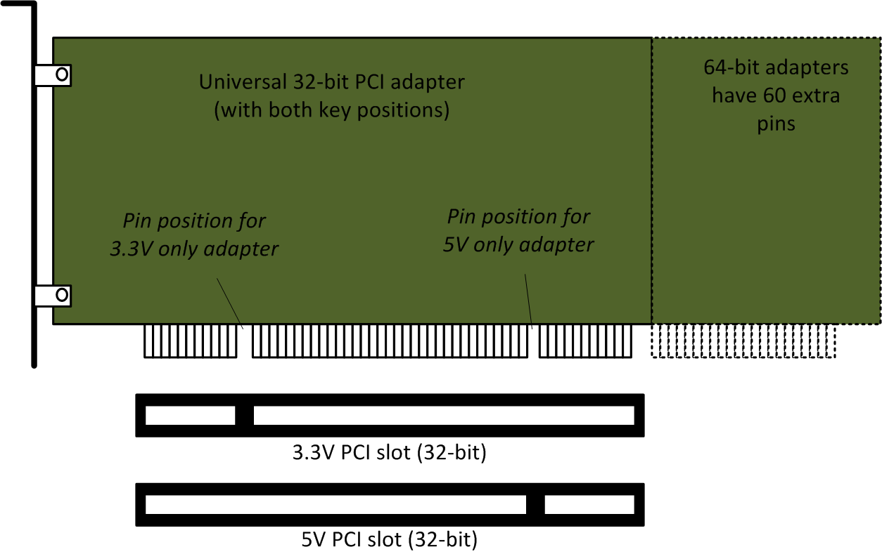
PCI Bus
Peripheral Component Interconnect introduced alongside Pentium CPU
Plug-and-Play and bus mastering
Shared bandwidth
  32-bit @ 33 MHz (most desktop PCs)
  64-bit @ 33 MHz – 533 MHz (PCI, PCI-X)
5V signaling most prevalent though deprecated by later versions
Cards and slots are keyed to prevent 5V card being put in 3.3V slot or 3.3V card in 5V slot
Universal cards can use either slot
Unit 1.5 Peripherals and Expansion Slots
Slide <number>

Slide 9
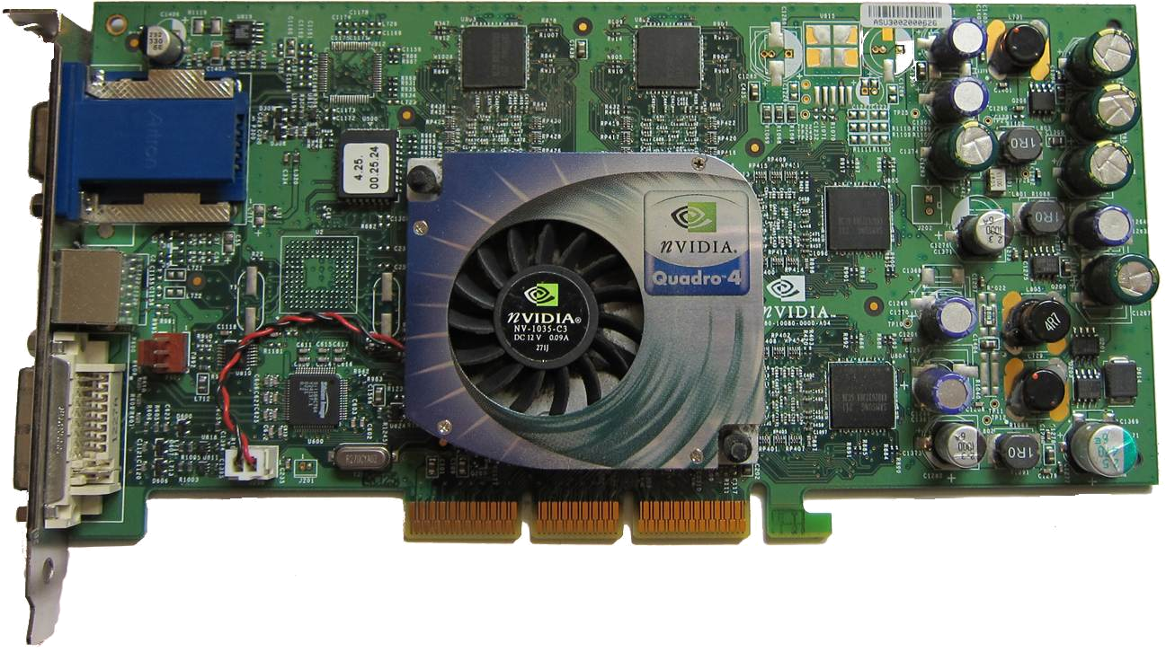
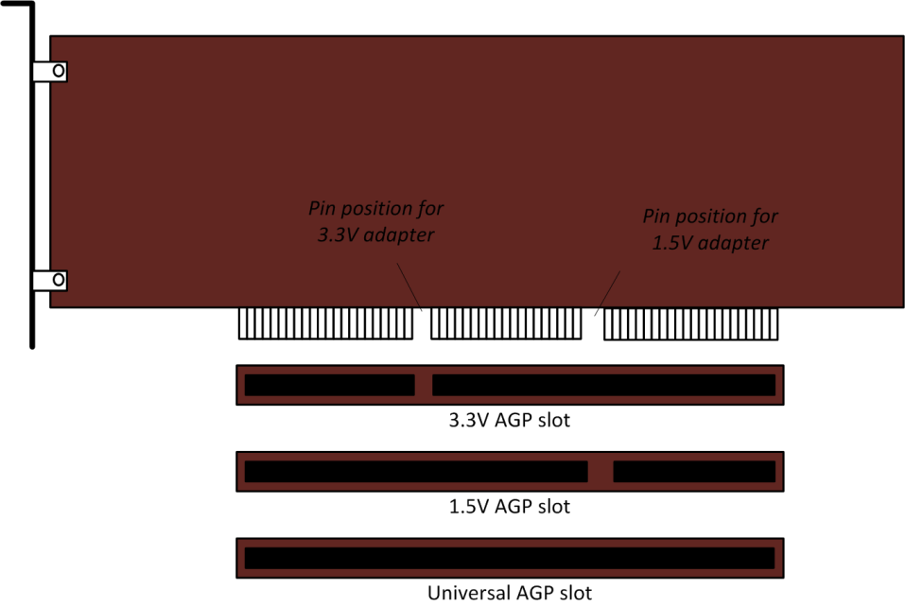
Accelerated Graphics Port (AGP)
AGP 1.0
  32-bit @ 66 MHz : 266 MBps
  AGP2x @ 133 MHz : 533 MBps
AGP 2.0
  AGP 4x
  1.5V signaling
AGP 3.0
  AGP 8x (2132 MBps)
AGP Pro
Unit 1.5 Peripherals and Expansion Slots
Slide <number>

Slide 10
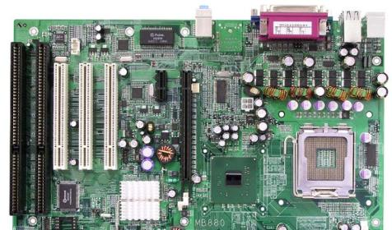
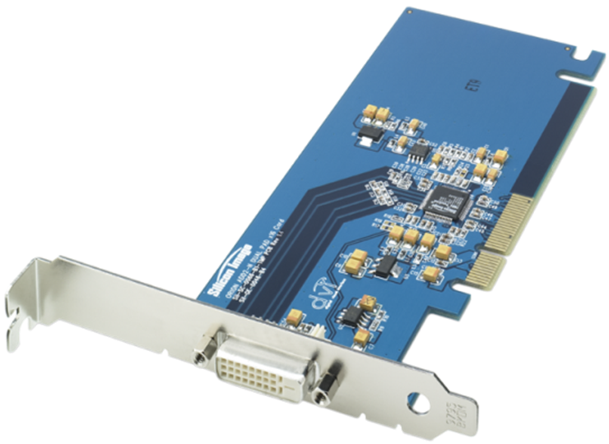
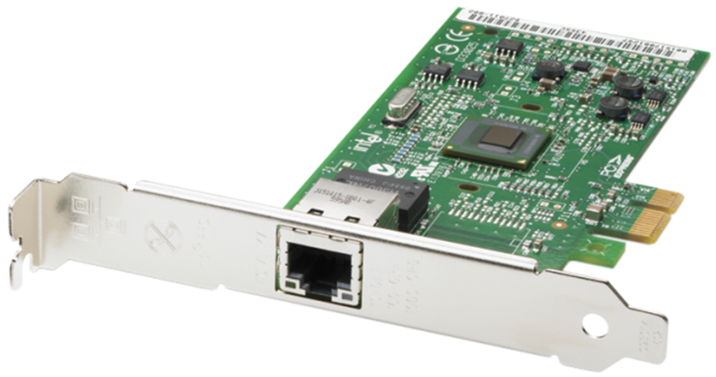
PCI Express (PCIe)
Serial, point-to-point links
Links can use multiplexed lanes (x1, x8, x16)
Each lane supports full duplex link
  250 MBps (v1)
  500 MBps (v2)
  1 GBps (v3)
Unit 1.5 Peripherals and Expansion Slots
Slide <number>

Slide 11
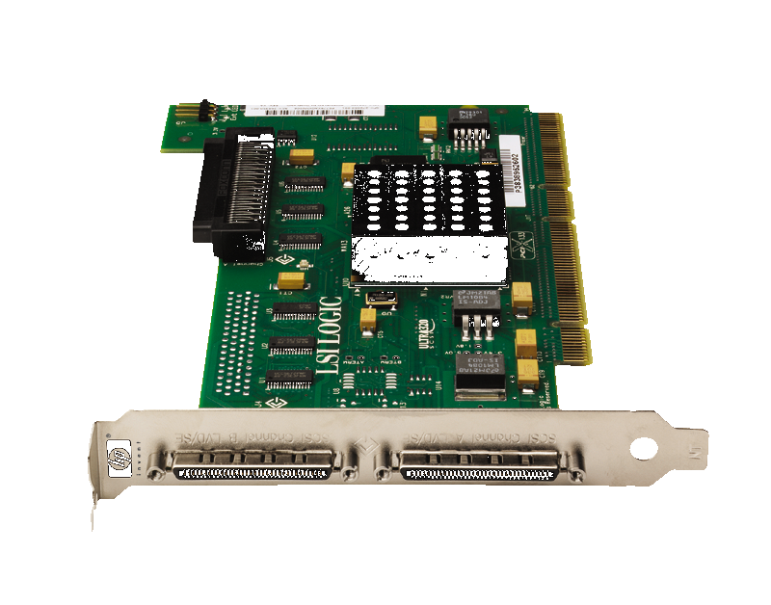
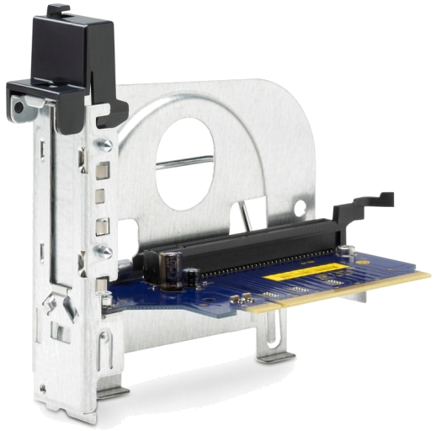
Adapter Cards
I/O
  USB / Firewire
  SCSI
Storage
  SATA
  SCSI
  RAID
Riser cards
Unit 1.5 Peripherals and Expansion Slots
Slide <number>

Slide 12
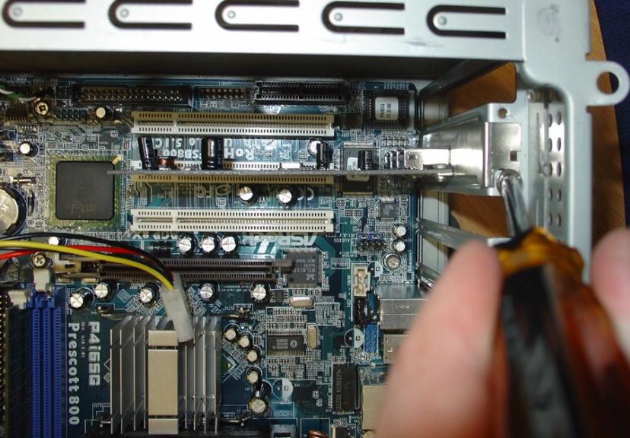
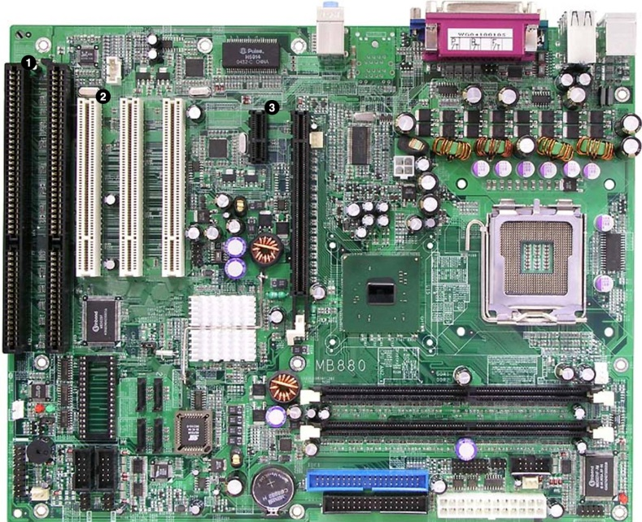
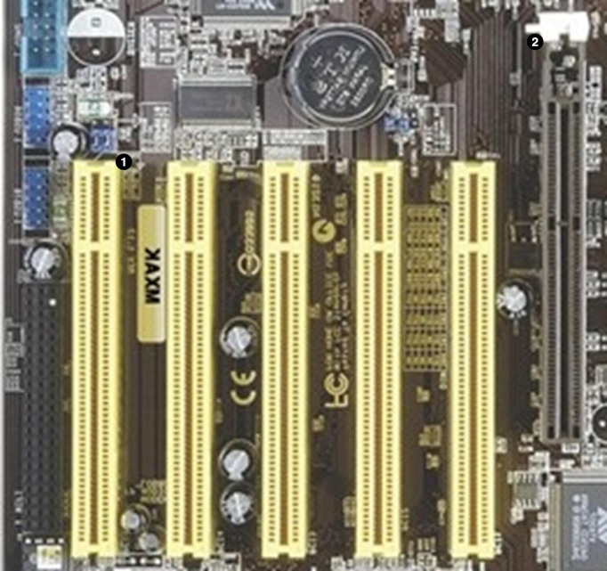
Installing Adapter Cards
Secure adapter to case with screw
Longer cards (AGP / PCIe graphics) may have retention clips at other end
PCI revisions and compatibility
AGP is used for graphics adapters only
Size of PCIe slots corresponds to the number of lanes
Unit 1.5 Peripherals and Expansion Slots
Slide <number>

Slide 13
Describe the functions and capabilities of input devices (Keyboard, Mouse, KVM, Game pad, Biometric devices, and touch screens)
Install and configure peripheral devices
Identify expansion bus slots and cards and describe the features of different bus standards
Install expansion cards
Unit 1.5 Peripherals and Expansion Slots
Slide <number>

